Slide 1
Applied Probability I Topic 3 – Random Variables
Dr. Bahman Honari
Fall 2020

Slide 2
Random Variable
We assign a unique number to every outcome in a sample space. The outcome of an experiment is then described as a single numerical value X, which is called a random variable.

Slide 3
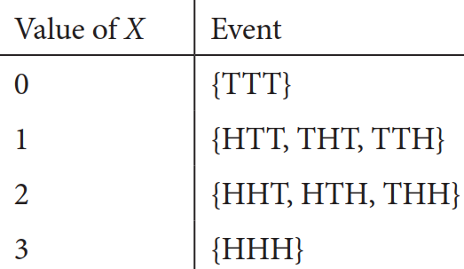

Random Variable
Example 3.1. Let X be the number of heads obtained in 3 tosses of a fair coin. The following tables show how a number is assigned to X from each outcome of an experiment.
The probabilities of X are given below.

Slide 4

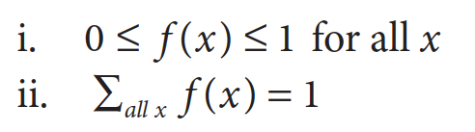
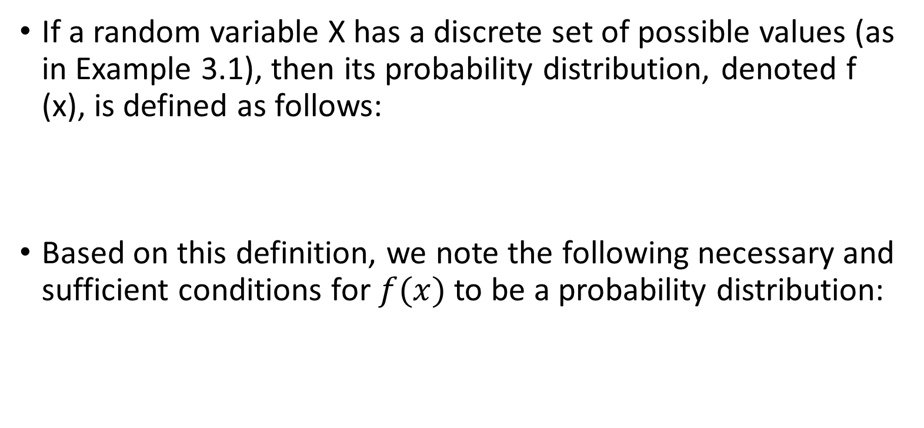
Probability Distribution
If a random variable X has a discrete set of possible values (as in Example 3.1), then its probability distribution, denoted f (x), is defined as follows:
Based on this definition, we note the following necessary and sufficient conditions for $f(x)$ to be a probability distribution:

Slide 5
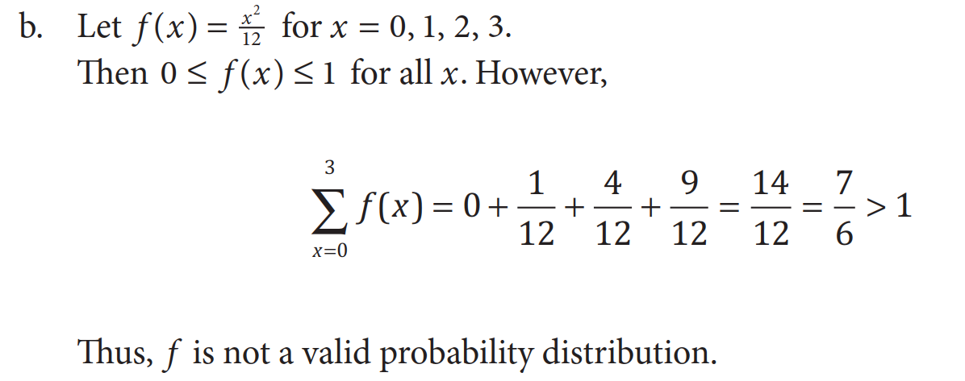
Probability Distribution
Example 3.2.

Slide 6
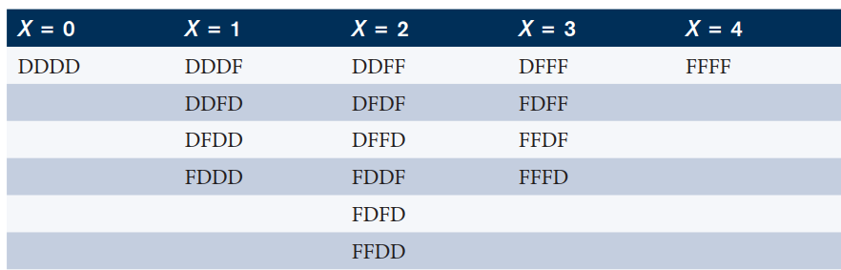
Probability Distribution
Example 3.3. 30% of the automobiles in a certain city are foreign made. Four cars are selected at random. Let X be the number of cars sampled that are foreign made.
Let F: foreign made, and D: domestic. The following table displays all possible outcomes for each value of X.

Slide 7
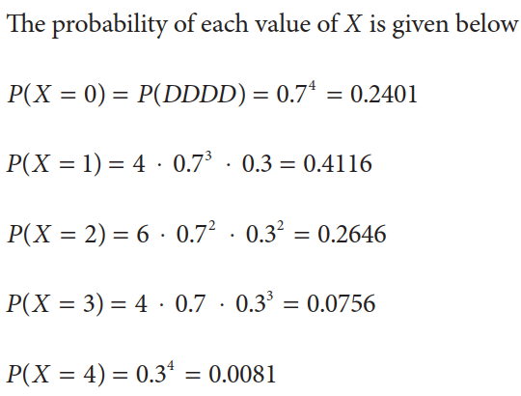
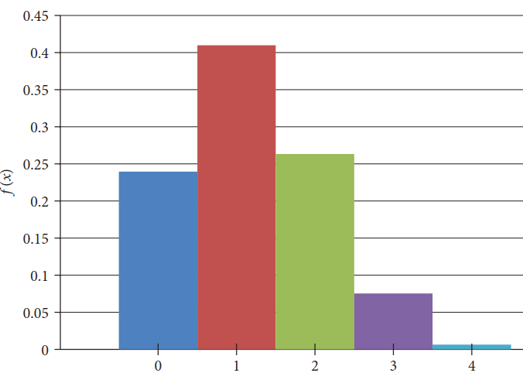
Probability Distribution
Example 3.3.Cont

Slide 8
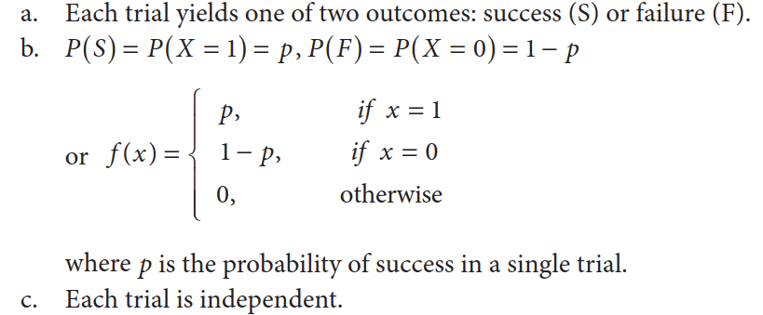
Probability Distribution
Example 3.4. Bernoulli trials have the following properties:

Slide 9
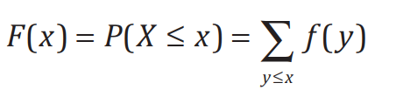
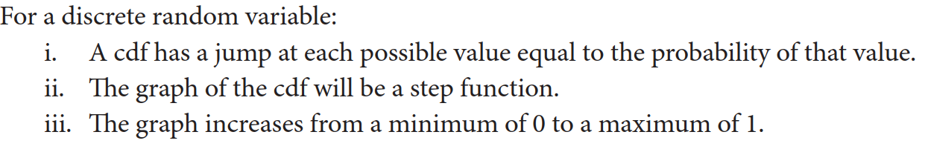
Cumulative Distribution Function (CDF)

Slide 10
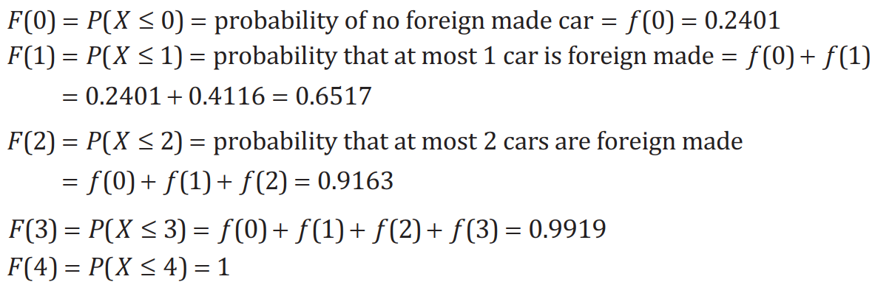
Cumulative Distribution Function (CDF)
Example 3.3.Cont . From the automobile example in Example 3.3, the distribution of X was obtained as follows:
and thus the cdf is given as follows

Slide 11
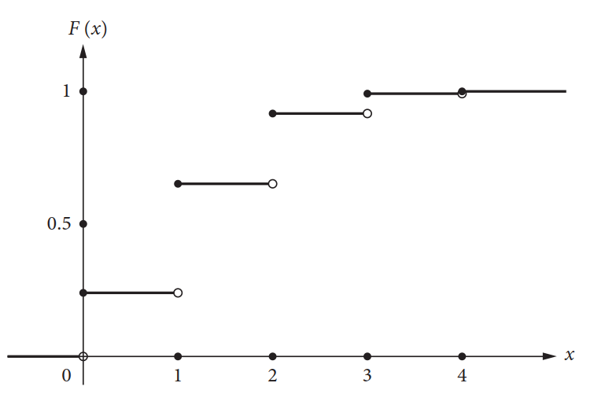
Cumulative Distribution Function (CDF)
Example 3.3.Cont .

Slide 12
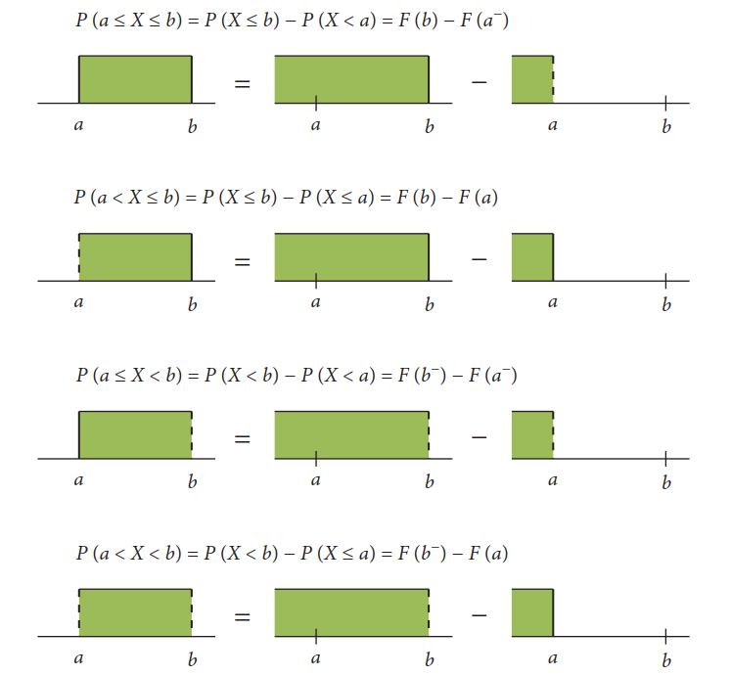

Cumulative Distribution Function (CDF)
The probability of a discrete distribution varies depending on the inclusion and exclusion of the boundary values. Figures below show the probability expressed in terms of cdf ’s for $a <b$ in each case. In this figure, $a−$ denotes a number that is less than a by an infinitesimally small value.

Slide 13
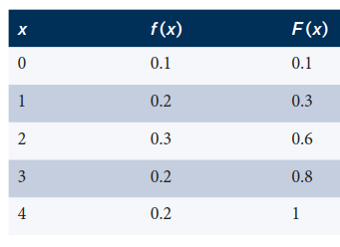
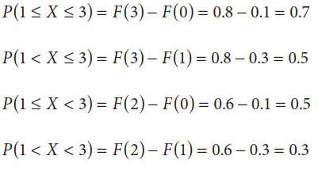
Cumulative Distribution Function (CDF)
Example 3. 5. Let’s X have the following distribution:
Then we have:

Slide 14
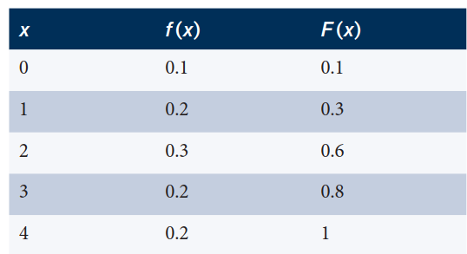
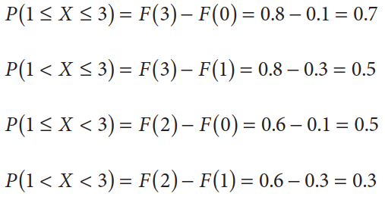
Cumulative Distribution Function (CDF)

Slide 15
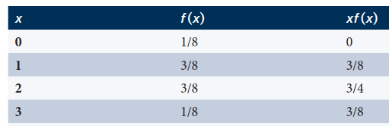
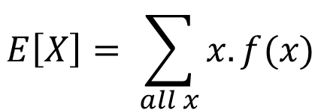
Expected Value
The mean (expected value) of a discrete random variable X is defined as follows:
$$E\left[X\right]= \sum_{all x}{x. f(x)}$$
Example 3. 6. Let’s X have the following distribution:
In this example, E(X) =1.5 . This means that if this experiment were repeated an extremely large number of times, the average number of heads obtained per experiment would be very close to 1.5.

Slide 16
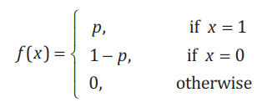
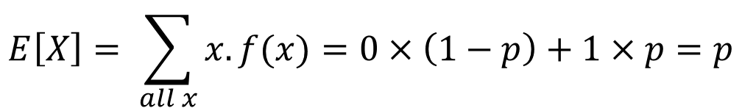
Expected Value
Example 3. 7. Let’s X have the following Bernoulli distribution:
Then we have:
$$E\left[X\right]= \sum_{all x}{x. f(x)}=0×\left(1−p\right)+1×p=p$$

Slide 17

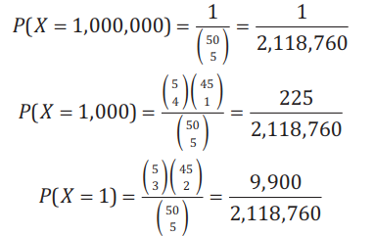

Expected Value
Example 3. 8. In a state lottery, a player picks 5 different integers between 1 and 50. If all 5 of these numbers are drawn, the prize is €1,000,000. If 4 of the 5 match,
the prize is $1,000. If 3 of the 5 match, the prize is a free lottery ticket (worth €1). Matching 2 or fewer of the numbers earns no prize. For an individual player, what is the expected prize?

Slide 18
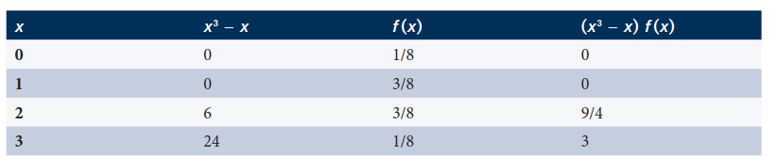

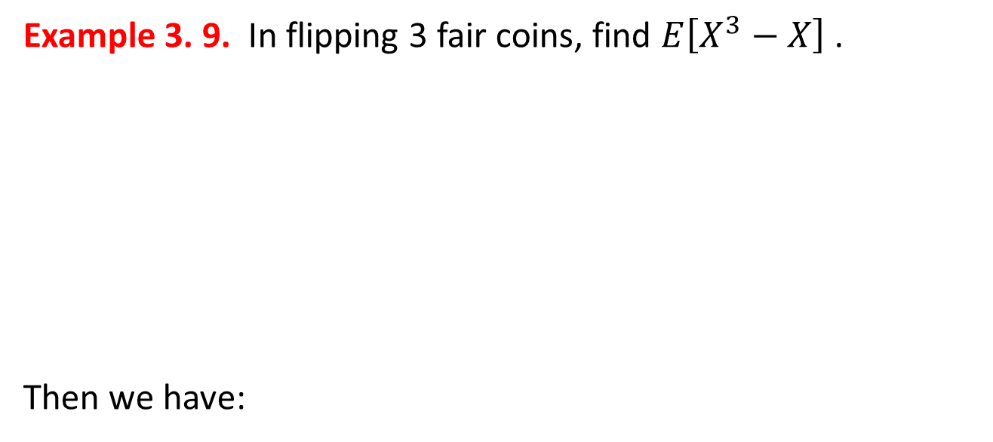
Expected Value
Example 3. 9. In flipping 3 fair coins, find $E\left[X^{3}−X\right]$.
Then we have:

Slide 19
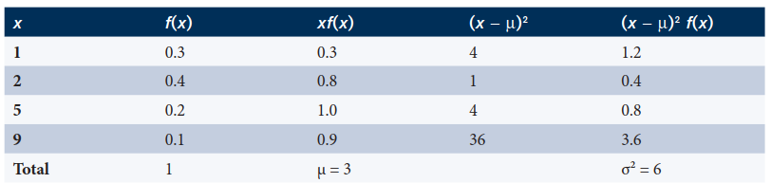
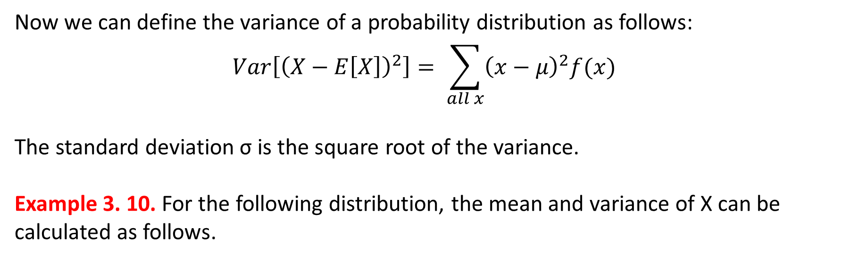
Variance
Now we can define the variance of a probability distribution as follows:
$$Var\left[{\left(X−E\left[X\right]\right)}^{2}\right]= \sum_{all x}{{\left(x−μ\right)}^{2}f(x)}$$
The standard deviation σ is the square root of the variance.
Example 3. 10. For the following distribution, the mean and variance of X can be
calculated as follows.

Slide 20
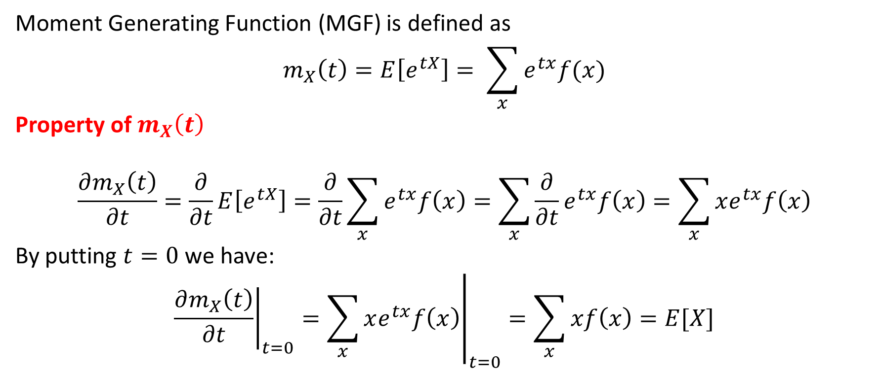
Moment Generating Function
Moment Generating Function (MGF) is defined as
$$m_{X}\left(t\right)=E\left[e^{tX}\right]= \sum_{x}{e^{tx}f(x)}$$
Property of $m_{X}\left(t\right)$
$$\frac{∂m_{X}\left(t\right)}{∂t}=\frac{∂}{∂t}E\left[e^{tX}\right]=\frac{∂}{∂t}\sum_{x}{e^{tx}f\left(x\right)}=\sum_{x}{\frac{∂}{∂t}e^{tx}f\left(x\right)}=\sum_{x}{xe^{tx}f\left(x\right)}$$
By putting $t=0$ we have:
$${\left.\frac{∂m_{X}\left(t\right)}{∂t}\right|}_{t=0}={\left.\sum_{x}{xe^{tx}f\left(x\right)}\right|}_{t=0}=\sum_{x}{xf\left(x\right)}=E[X]$$

Slide 21

Moment Generating Function
Similarly:
$${\left.\frac{∂^{k}m_{X}\left(t\right)}{∂t^{k}}\right|}_{t=0}=\frac{∂^{k}}{∂t^{k}}{\left.\sum_{x}{e^{tx}f\left(x\right)}\right|}_{t=0}={\left.\sum_{x}{\frac{∂^{k}}{∂t^{k}}e^{tx}f\left(x\right)}\right|}_{t=0}={\left.\sum_{x}{x^{k}e^{tx}f\left(x\right)}\right|}_{t=0}$$
$$=\sum_{x}{x^{k}f\left(x\right)}=E[X^{k}]$$

Slide 22
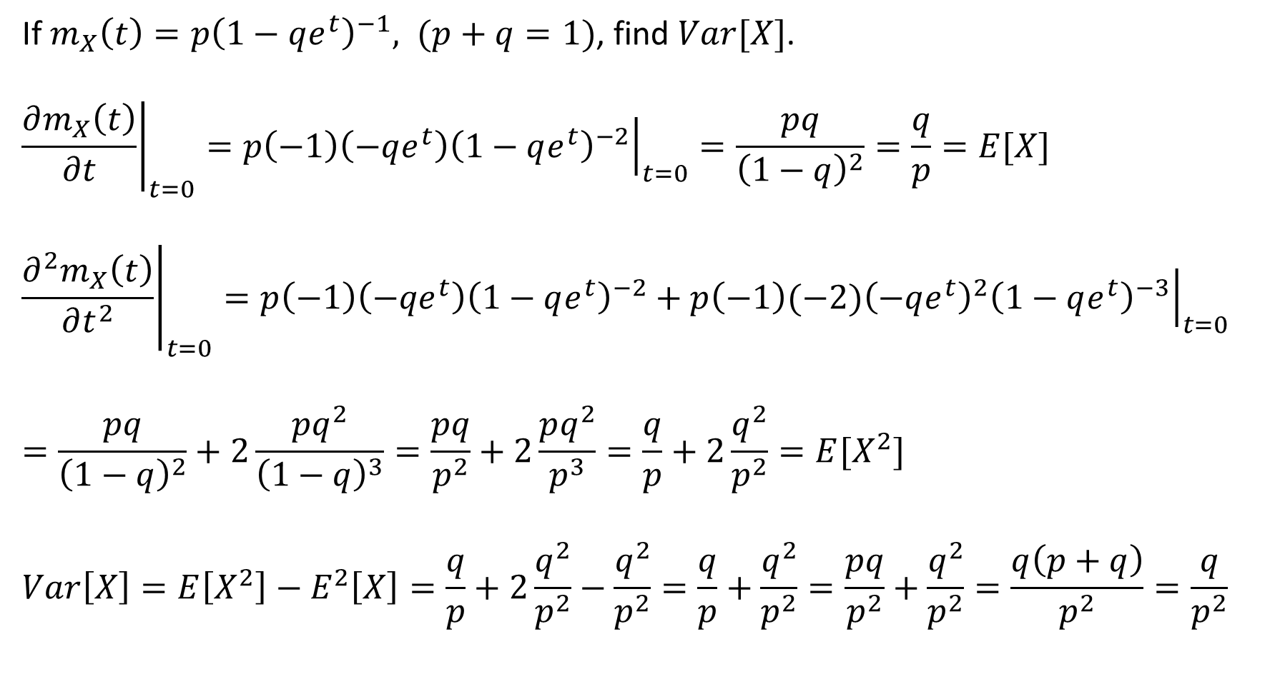
Moment Generating Function - Example
If $m_{X}\left(t\right)=p{\left(1−qe^{t}\right)}^{−1}, (p+q=1)$, find $Var[X]$.
$${\left.\frac{∂m_{X}\left(t\right)}{∂t}\right|}_{t=0}={\left.p\left(−1\right)\left(−qe^{t}\right){\left(1−qe^{t}\right)}^{−2}\right|}_{t=0}=\frac{pq}{{\left(1−q\right)}^{2}}=\frac{q}{p}=E[X]$$
$${\left.\frac{∂^{2}m_{X}\left(t\right)}{∂t^{2}}\right|}_{t=0}={\left.p\left(−1\right)\left(−qe^{t}\right){\left(1−qe^{t}\right)}^{−2}+p\left(−1\right){(−2)\left(−qe^{t}\right)}^{2}{\left(1−qe^{t}\right)}^{−3}\right|}_{t=0}$$
$$=\frac{pq}{{\left(1−q\right)}^{2}}+2\frac{pq^{2}}{{\left(1−q\right)}^{3}}=\frac{pq}{p^{2}}+2\frac{pq^{2}}{p^{3}}=\frac{q}{p}+2\frac{q^{2}}{p^{2}}=E[X^{2}]$$
$$Var\left[X\right]=E\left[X^{2}\right]−E^{2}\left[X\right]=\frac{q}{p}+2\frac{q^{2}}{p^{2}}−\frac{q^{2}}{p^{2}}=\frac{q}{p}+\frac{q^{2}}{p^{2}}=\frac{pq}{p^{2}}+\frac{q^{2}}{p^{2}}=\frac{q\left(p+q\right)}{p^{2}}=\frac{q}{p^{2}}$$

